Slide 1



LOOKER TRAINING FOR BEGINNERS
By Devarajan Palaniappan (DATA POLE)
Session 2

Slide 2
LookML Overview LookML Structures Project Model Explore Views Dimensions Measure Types of Looker Extensions Types of LookML Parameters Column Limits Row Limits
Table of Contents

Slide 3
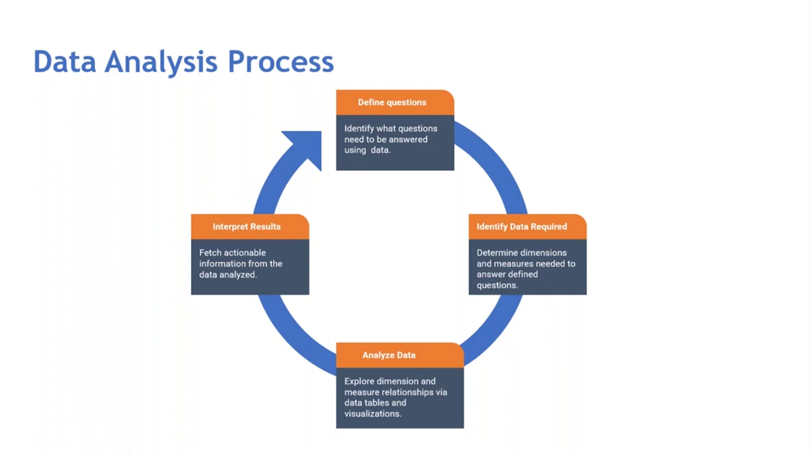

Slide 4
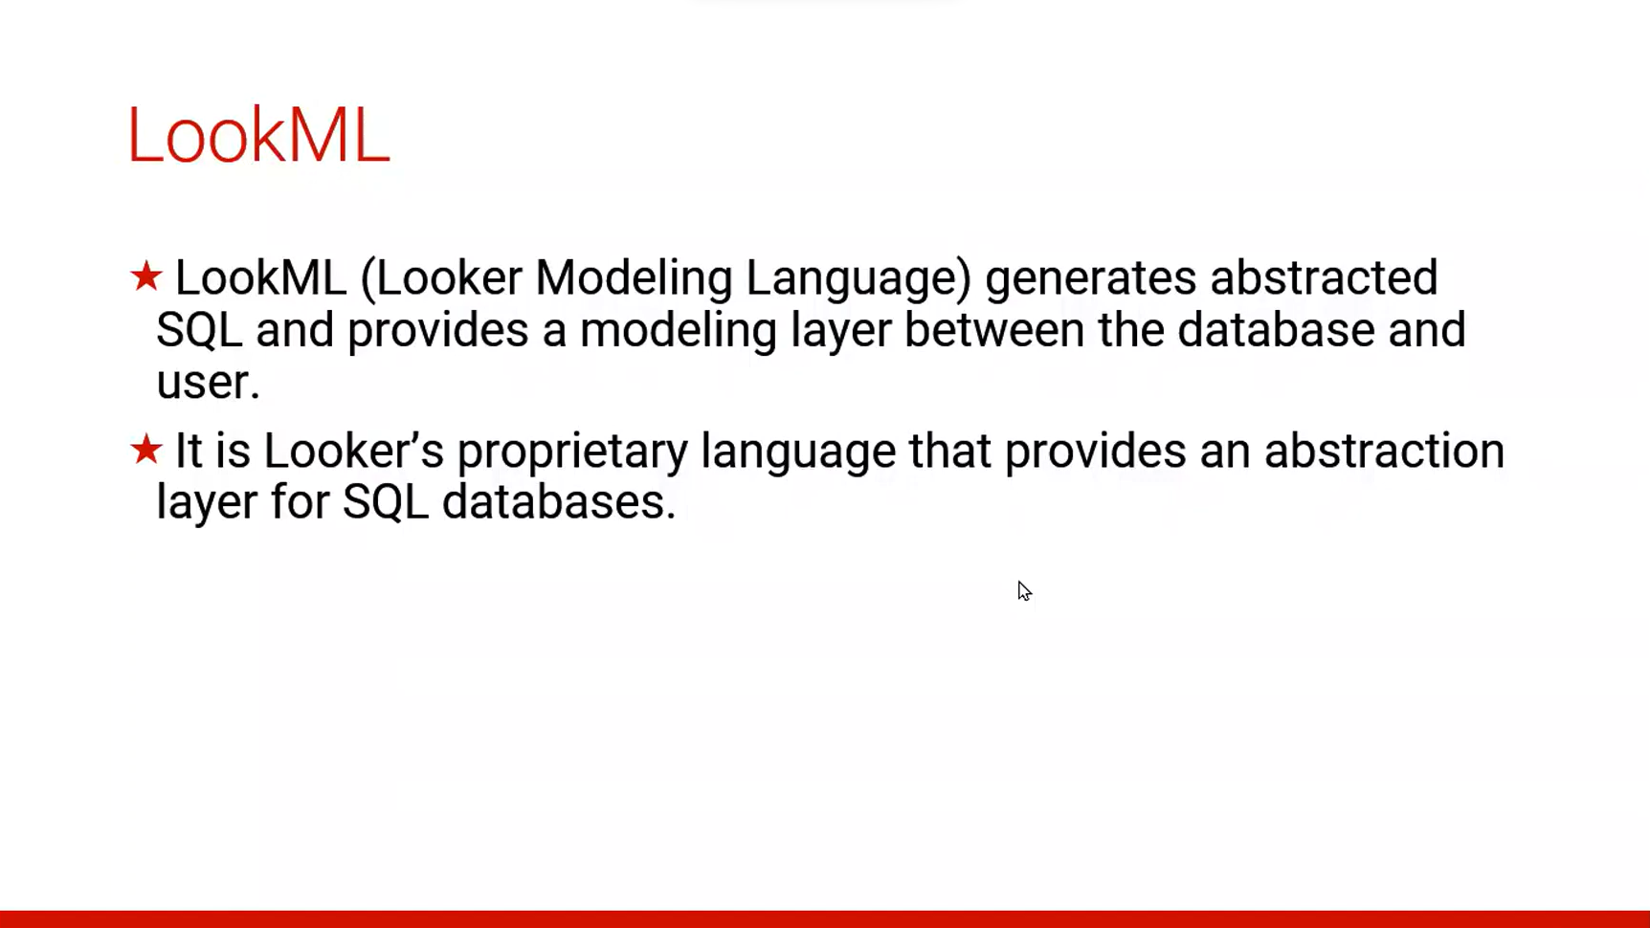

Slide 5
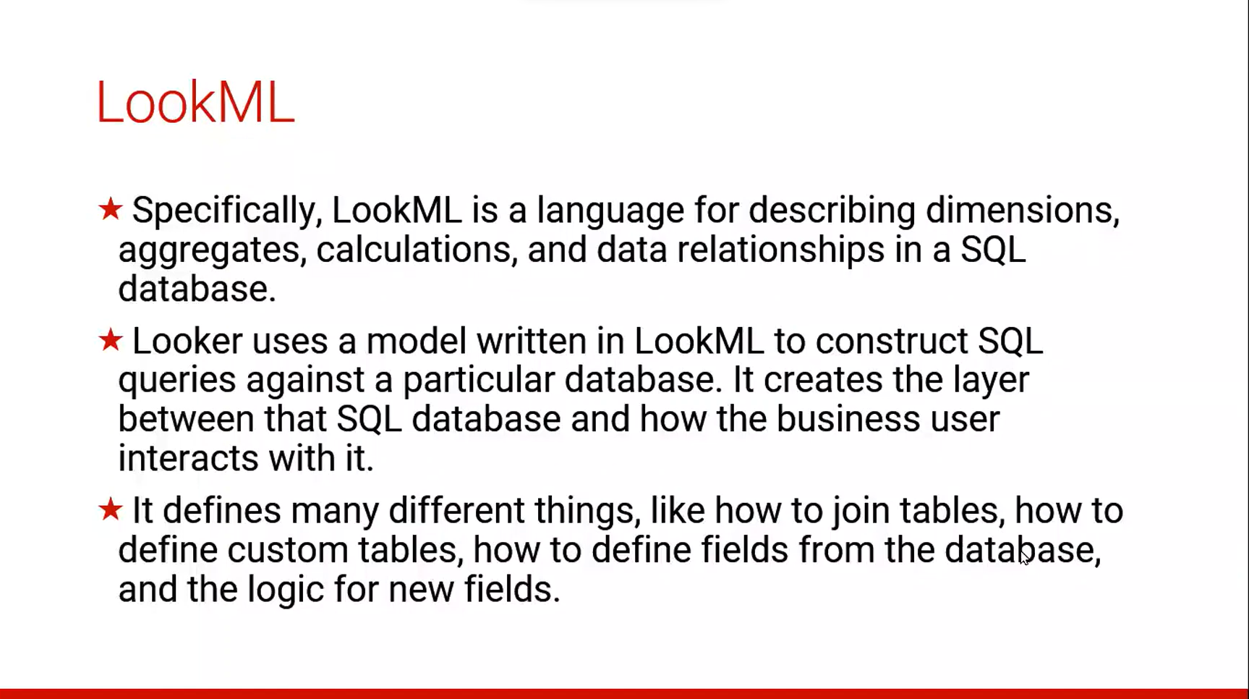

Slide 6
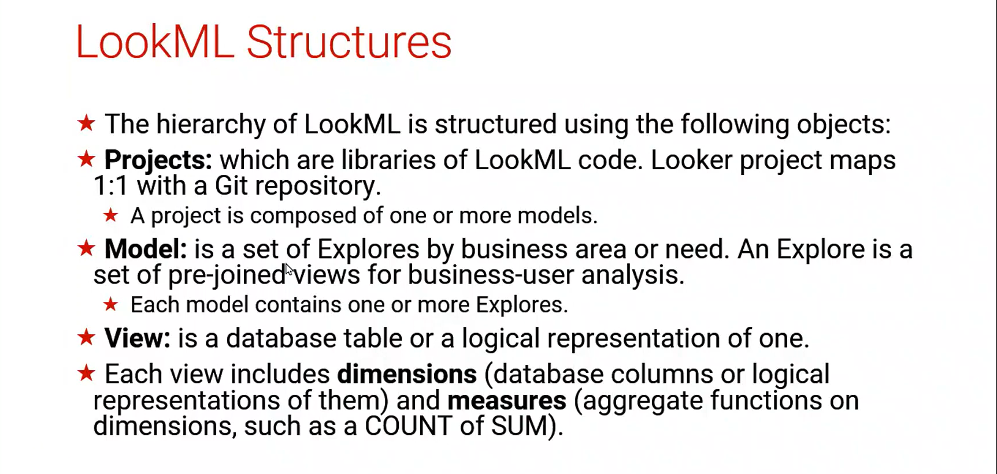

Slide 7
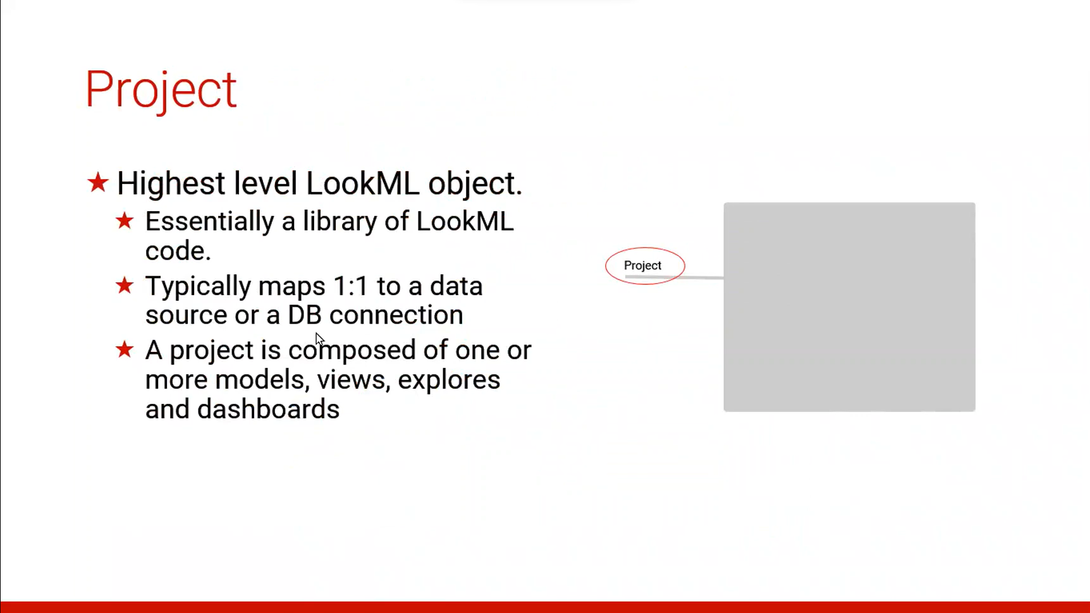

Slide 8
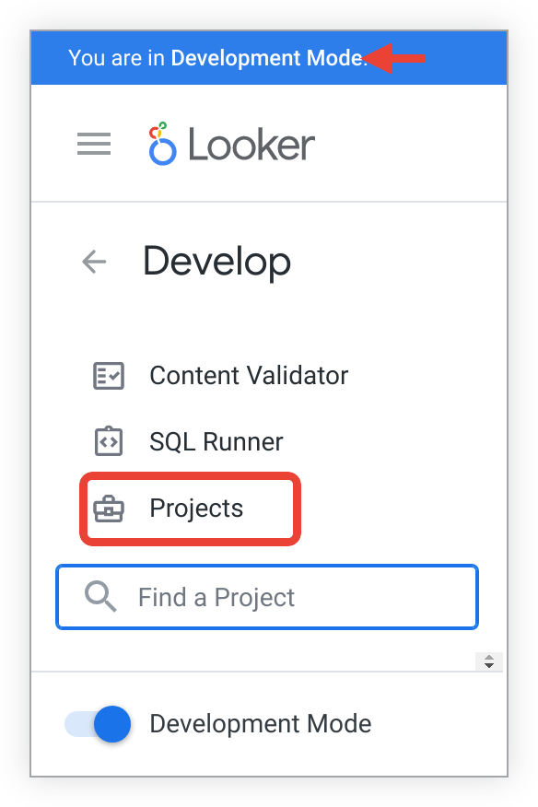
Creating a new LookML project
A project is a collection of LookML files that describe how your database tables are related to each other and how Looker should interpret those tables.
A LookML project can contain more than one model file. However, if you want to specify permissions for users around seeing and editing LookML for a specific model file, you might want to create a new project. Although most permissions in Looker apply at the model level
Creating a project
To create a project, perform the following steps:
Verify that you are in Development Mode.
Select Projects from the Develop section of the navigation panel.

Slide 9
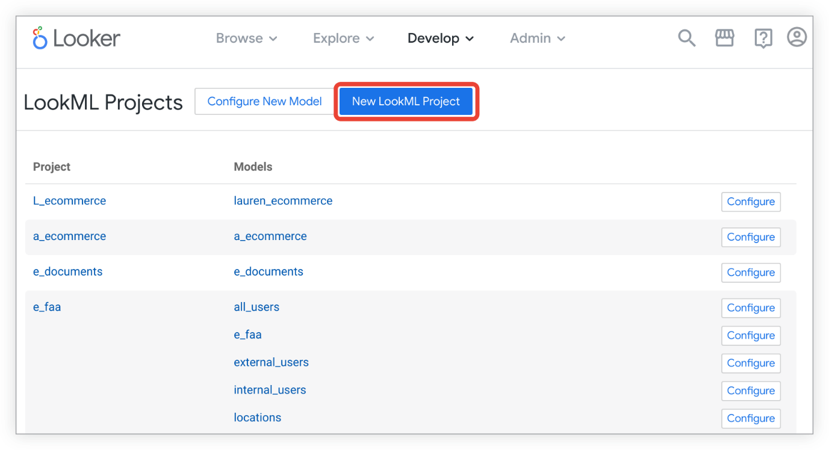
3.On the LookML Projects page, select New LookML Project to select the options for your project.
This action opens the New Project page, where you can specify settings for your project, including the project's name and starting point. Looker can create a project in several ways, and the steps taken depend on the Starting Point option you choose on the New Project page. The following sections describe how these starting points work:
Automatically generating a model from your database
Cloning a public Git repository
Creating a blank project
Note: If you are a Looker admin and you want to rename your project after you've created it, use the Project Settings page
Automatically generating a model from your database
If you select Generate Model from Database Schema as the starting point, the LookML generator automatically creates your model and view project files based on the tables in your database.
With this option, Looker asks for the connection name so that it can automatically generate LookML based your database. However, you can still add additional connections later.
Cloning a public Git repository
If you select Clone Public Git Repository as the starting point, Looker will copy the files from a public Git repository into your new LookML project.

Slide 10
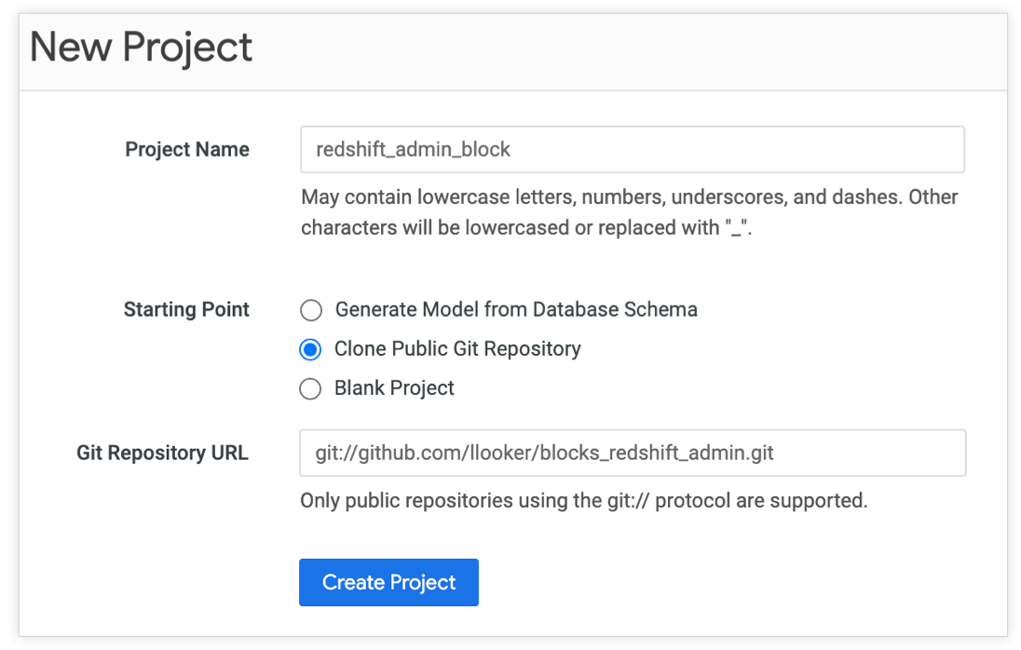
Looker projects that are cloned from public Git repositories are read-only. However, you can import the read-only project into another of your Looker projects, where you can then edit the files.
Additionally, you can use the cloned repository files as a starting point, then use the Looker extends parameter or refinements to build up a project from there.
To clone an existing public Git repository into a Looker project:
Verify that you are in Development Mode.
Select Manage LookML Projects from the Develop menu.
From the LookML Projects page, select New LookML Project to open the New Project page.
On the New Project page, specify the options for your project:
Project Name: Give your project a name.
Starting Point: Choose Clone Public Git Repository.
Git Repository URL: Enter the URL for the public Git repository. Make sure that the URL is in the format git://github.com/example/my-repository.git.
If you have a URL such as https://github.com/llooker/blocks_redshift_admin, you can edit it use to the correct format by replacing "https://" with "git://" and then adding ".git" at the end. The URL you would enter would be git://github.com/llooker/blocks_redshift_admin.git.
Select Create Project. Looker will pull all the public repository's files into a new LookML project and open the project in the Looker IDE.

Slide 11
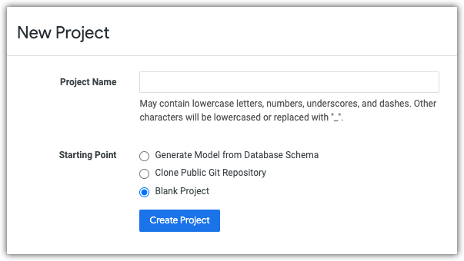
Creating a blank project
If you select Blank Project as the starting point, Looker creates an empty project so that you can create your LookML files from scratch.
To create a blank project:
Verify that you are in Development Mode.
Select Manage LookML Projects from the Develop menu.
From the LookML Projects page, select New LookML Project to open the New Project page.
On the New Project page, specify the options for your project:
Project Name: Give your project a name.
Starting Point: Choose Blank Project.
Select Create Project. Looker creates the project and opens it in the Looker IDE.
Once you have a blank project, you can create model and view files, and then you can connect your project to Git so that you can record changes to your LookML files and manage versions of your files.
Configuring a model
Use the Configure New Model button at the top of the LookML Projects page to add a configuration for an existing or a planned model.
Configuring a model for a project that doesn't exist yet is useful if the developers have not been given either the manage_models permission or the manage_project_models permission, as described on the Generating a model documentation page. If you configure the model for the developers, then they will be able to run queries as soon as they generate or create the model file.

Slide 12
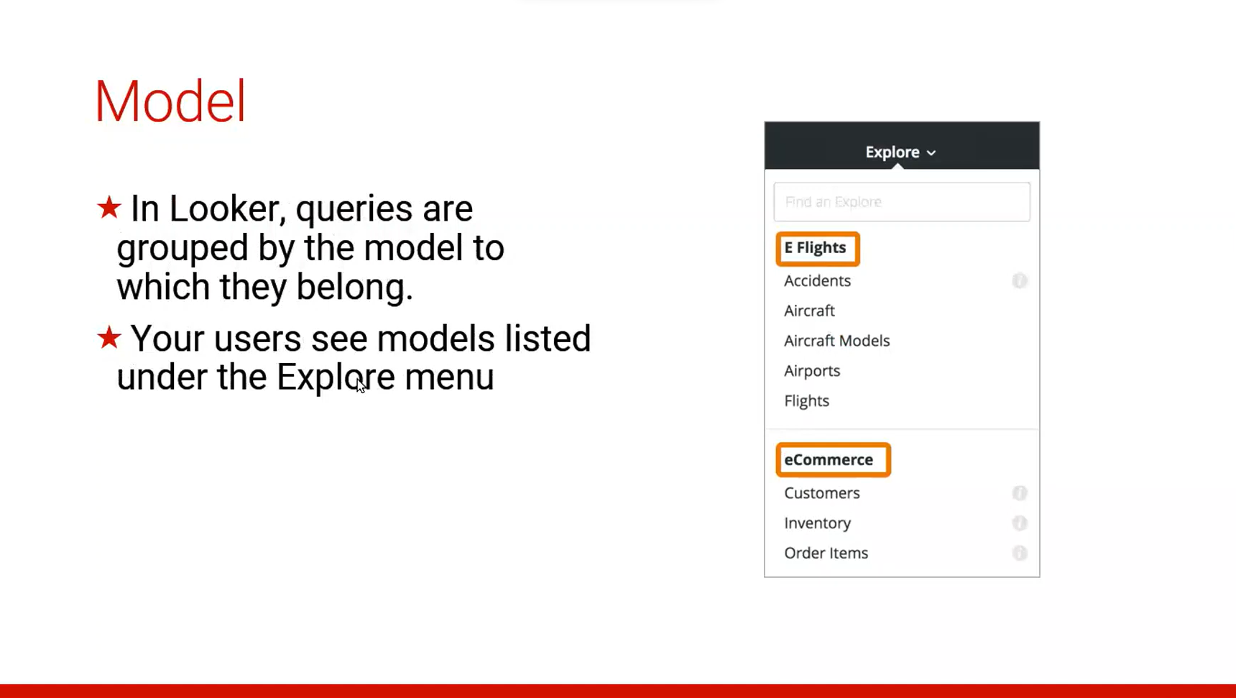
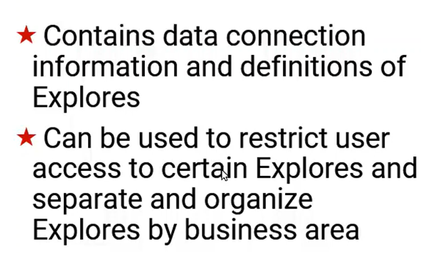

Slide 13
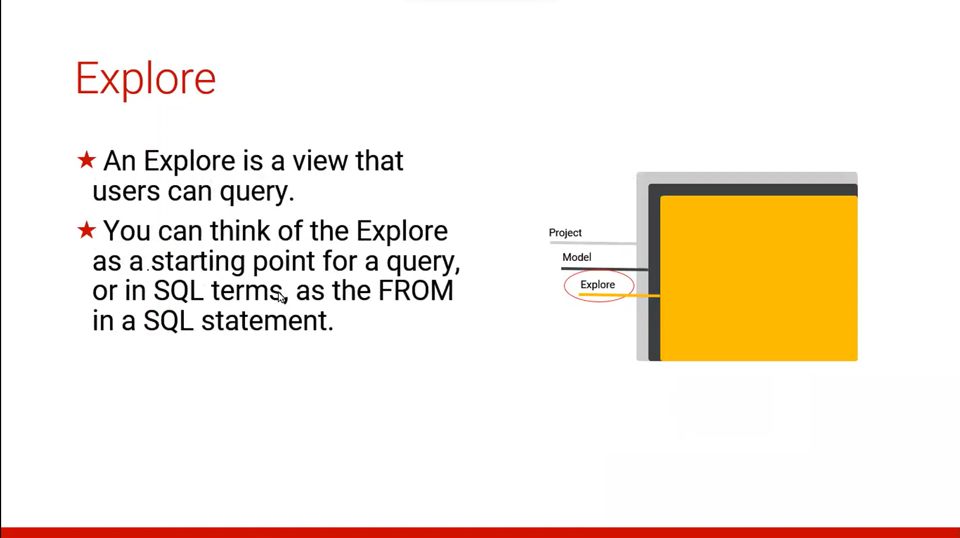
Explore Syntax:
#explore: users {
}
#explore: events {
from: user_events
} (Special Rules : explore names must be unique within a given mode)

Slide 14
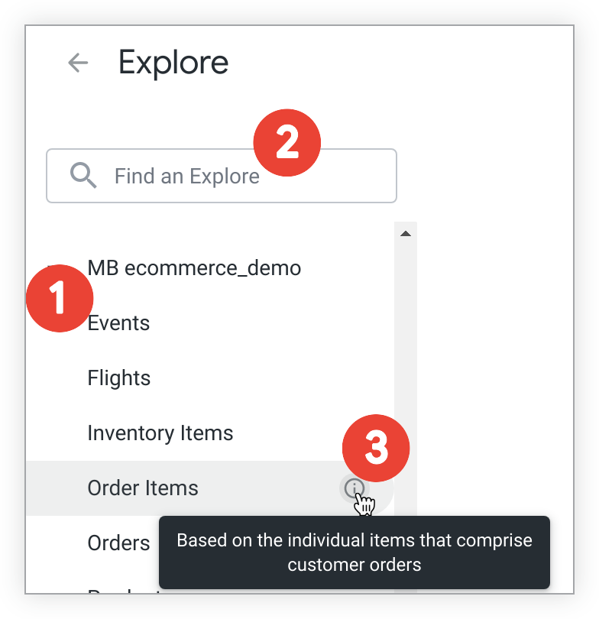
How the project is set up, and the specific contents of its files, determines what users see and how they can interact with Looker.
The Explore panel in the left navigation panel is organized by model names. Under each model name is a list of available Explores that are defined in that model.
Users can search for a specific Explore.
Developers can include descriptions for Explores, which users can view on hover.

Slide 15
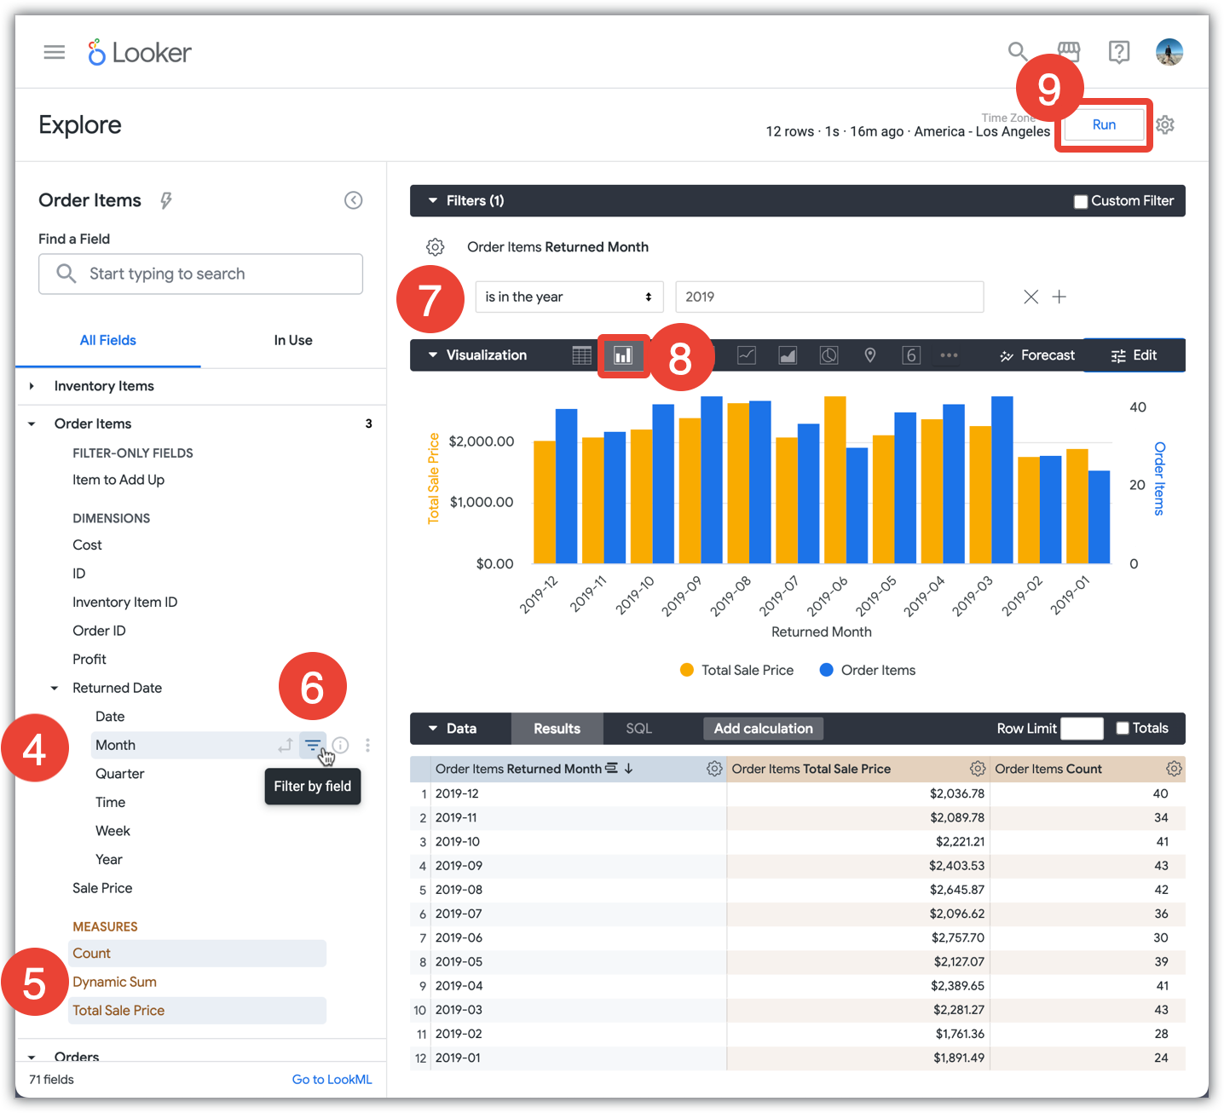
4.The field picker pane is organized by view names. Under each view name is a list of available fields from the tables included in that view. Most views show both dimensions and measures. This example selects a Month dimension from within a Returned Date dimension group, which was defined in the view file.
5.Users can select multiple measures on which to base the query.
6.Users can apply options like filters and pivots in the field picker pane.
7.Users can refine the terms of the query.
8.Users can choose a visualization type to apply to the query results.
9.Running this Explore generates a SQL query that returns both a data table and a visualization of the total sale price and total gross margin of the returned orders from the past year.

Slide 16
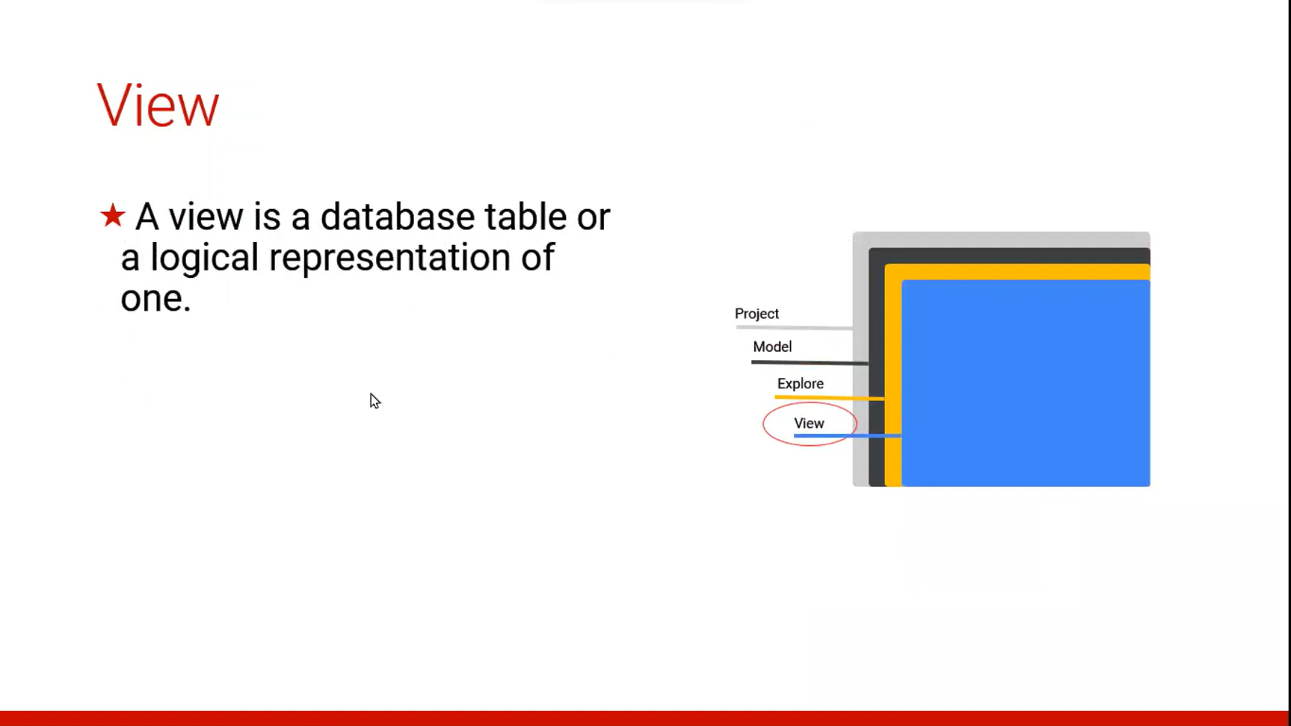
Syntax:
view: view_name { ... }
Example:
view: orders {}
Common Challenges:
view usually contains dimensions and measures
A view is not accessible by users until added using explore or join
Two views must be referred to by different names within an Explore
Tables referenced by view must be accessible from the current connection

Slide 17
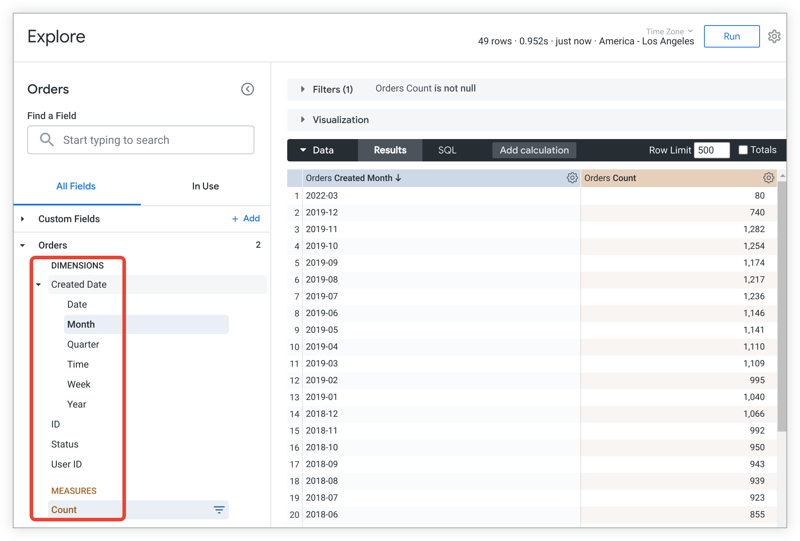
Views

Slide 18
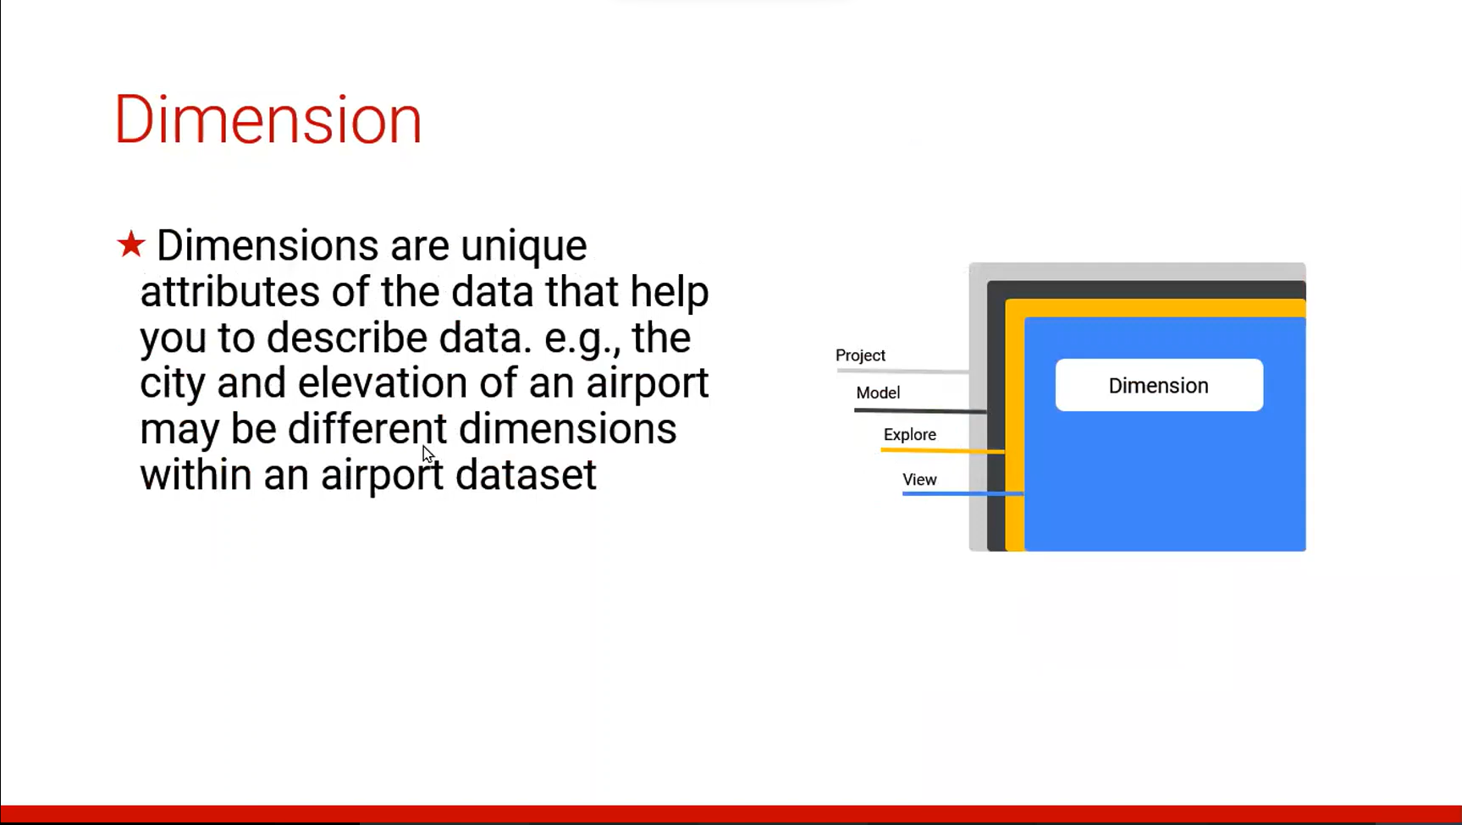

Slide 19
Definition of Dimension:
The dimension parameter declares a new dimension and specifies a name for that dimension. The name must meet the following requirements:
It must be unique within any given view.
It must consist of characters a through z, 0 through 9, or _. The dimension name is case-sensitive. Because of this, we recommend using a consistent lowercase name for all LookML objects, including dimensions.
It must start with a letter.
Code Sample of Dimension: Create an id and a supplier_name dimension in a view named products:
view: products {
dimension: id {
primary_key: yes
sql: ${TABLE}.id ;;
}
dimension: supplier_name {
sql: ${TABLE}.supplier_name ;;
}
}

Slide 20
Dimension Data Types:
Type | Description
bin | ADDED 21.14 For fields that group numerical values into several ranges
date | For fields that contain dates
date_time | For fields that contain dates and times
distance | For fields that calculate the distance of the most direct path ("as the crow flies") between two type: location dimensions
duration | Used with a dimension_group to create several duration-based dimensions from a single table column. For information about dimension groups, see the dimension_group parameter documentation page.
location | For fields that are based on a latitude and longitude and will be used in visualizations
number | For fields that contain numbers
string | For fields that contain letters or special characters
tier | For fields that group numerical values into several ranges
time | Used with a dimension_group to create several time-based dimensions from a single table column. For information about dimension groups, see the dimension_group parameter documentation page.
unquoted | For parameter fields whose values will be inserted directly into SQL, and therefore should not be quoted (as they would with type: string)
yesno | For fields that show if something is true or false
zipcode | For fields that contain a zip code and will be used in visualizations
Individual Time and Date Types | A rarely used alternative to type: time for creating single, time-based dimensions
Individual Duration Types | A rarely used alternative to type: duration for creating single time-based dimensions that calculate time differences

Slide 21
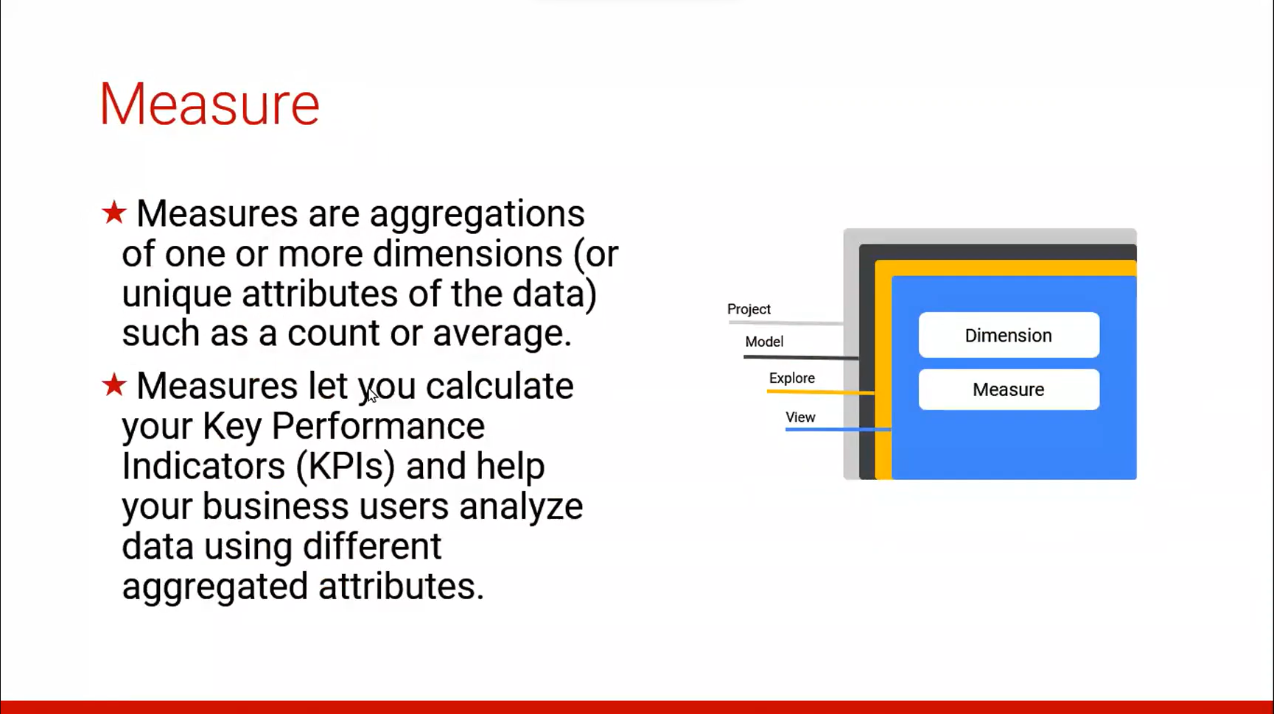

Slide 22
Measure types
Syntax:
view: view_name {
measure: field_name {
type: measure_field_type
}
}
Each measure type falls into one of the following categories. These categories determine whether the measure type performs aggregations, the type of fields that the measure type can reference, and whether you can filter the measure type using the filters parameter:
Aggregate measures: Aggregate measure types perform aggregations, such as sum and average. Aggregate measures can reference only dimensions, not other measures. This is the only measure type that works with the filters parameter.
Non-aggregate measures: Non-aggregate measures are, as the name suggests, measure types that do not perform aggregations, such as number and yesno. These measure types perform simple transformations, and since they do not perform aggregations, can reference only aggregate measures or previously-aggregated dimensions. You cannot use the filters parameter with these measure types.
Post-SQL measures: Post-SQL measures are special measure types that perform specific calculations after Looker has generated query SQL. They can reference only numeric measures or numeric dimensions. You cannot use the filters parameter with these measure types.

Slide 23
List of type definitions
Functions | Types Of Measure | Description
average | Aggregate | Generates an average (mean) of values within a column
average_distinct | Aggregate | Properly generates an average (mean) of values when using denormalized data.
count | Aggregate | Generates a count of rows
count_distinct | Aggregate | Generates a count of unique values within a column
list | Aggregate | Generates a list of the unique values within a column
max | Aggregate | Generates the maximum value within a column
median | Aggregate | Generates the median (midpoint value) of values within a column
median_distinct | Aggregate | Properly generates a median (midpoint value) of the values when a join causes a fanout.
min | Aggregate | Generates the minimum value within a column
percentile | Aggregate | Generates the value at the specified percentile within a column
percentile_distinct | Aggregate | Properly generates the value at the specified percentile when a join causes a fanout.
sum | Aggregate | Generates a sum of values within a column
sum_distinct | Aggregate | Properly generates a sum of values when using denormalized data.
date | Non-aggregate | For measures that contain dates
yesno | Non-aggregate | For fields that will show if something is true or false
string | Non-aggregate | For measures that contain letters or special characters (as with MySQL's GROUP_CONCAT function)
number | Non-aggregate | For measures that contain numbers
percent_of_previous | Post-SQL | Generates the percent difference between displayed rows
percent_of_total | Post-SQL | Generates the percent of total for each displayed row
running_total | Post-SQL | Generates the running total for each displayed row

Slide 24
Types of Extension in a LookML project:
A LookML project is a collection of LookML files that tell Looker how to connect to your database, how to query your data, and how to control the user interface's behavior.
You can access LookML project files either from the Develop section in Looker or from the UI
Project files are organized by your Looker developers using folders in the IDE.
All project files have extensions, although the extensions are hidden in the IDE list if your project isn't enabled for folders in the IDE.
Types of Extension in a Looker:
Model files with extension .model.lkml
View files with extension .view.lkml
Dashboard files with extension .dashboard.lookml
Data files with extension .topojson or .geojson or .json
Document files with extension .md
Project manifest files that are always named manifest.lkml
Manifest lock files with extension .lkml
Locale strings files with extension .strings.json
Explore files with extension .explore.lkml
Data test files with extension .lkml
Refinements files with extension .lkml

Slide 25

Types Of LookML Parameters:
The LookML parameter reference is organized by the major structures of a LookML project, from the highest-level structures to the most detailed components of a LookML project:
Project manifest parameters
Model parameters
Explore parameters
Join parameters
View parameters
Field parameters

Slide 26
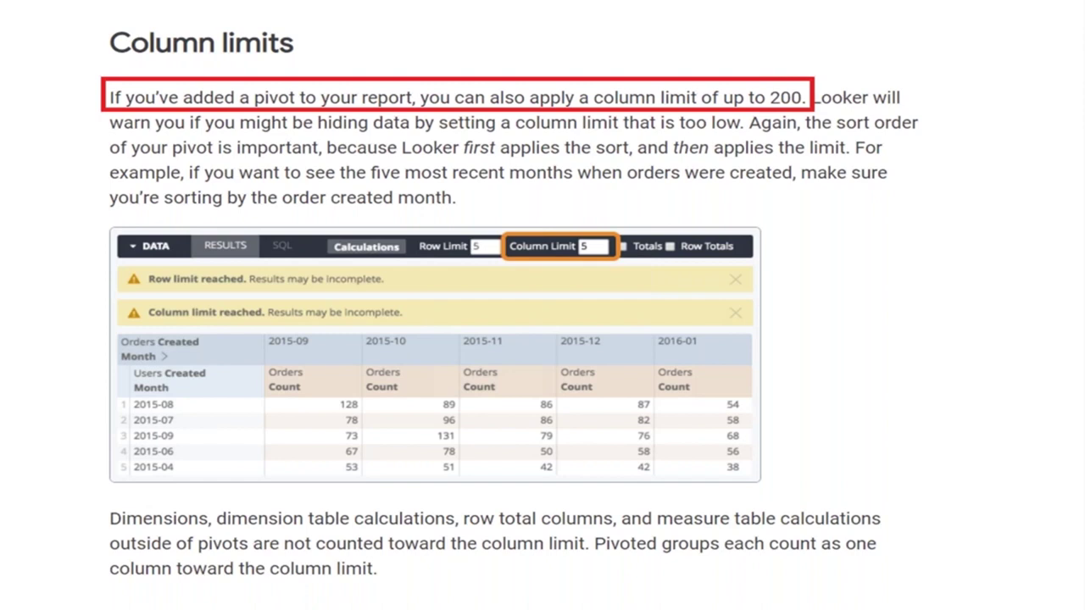

Slide 27
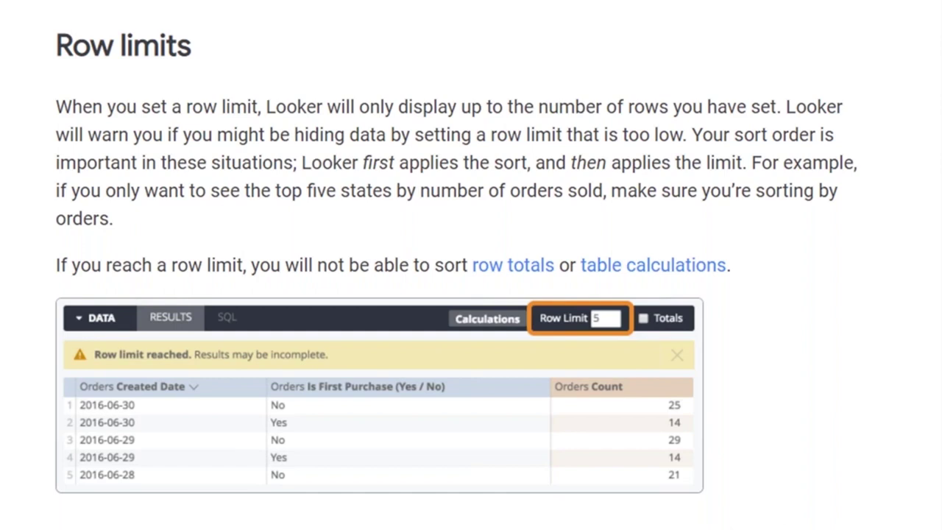

Slide 28
Row Limits:
Looker supports up to 5,000 rows and an unlimited number of columns for unpivoted queries. For browser performance, 50 or fewer columns is recommended.
Column Limits:
Looker supports up to 200 columns for pivoted queries, But sets a default column limit of 50 columns.
Analyse Type | Row Limits | Column Limits
Default | 5000 | 50
Pivoted queries |  | 200

Slide 29


Slide 30


